Slide 1
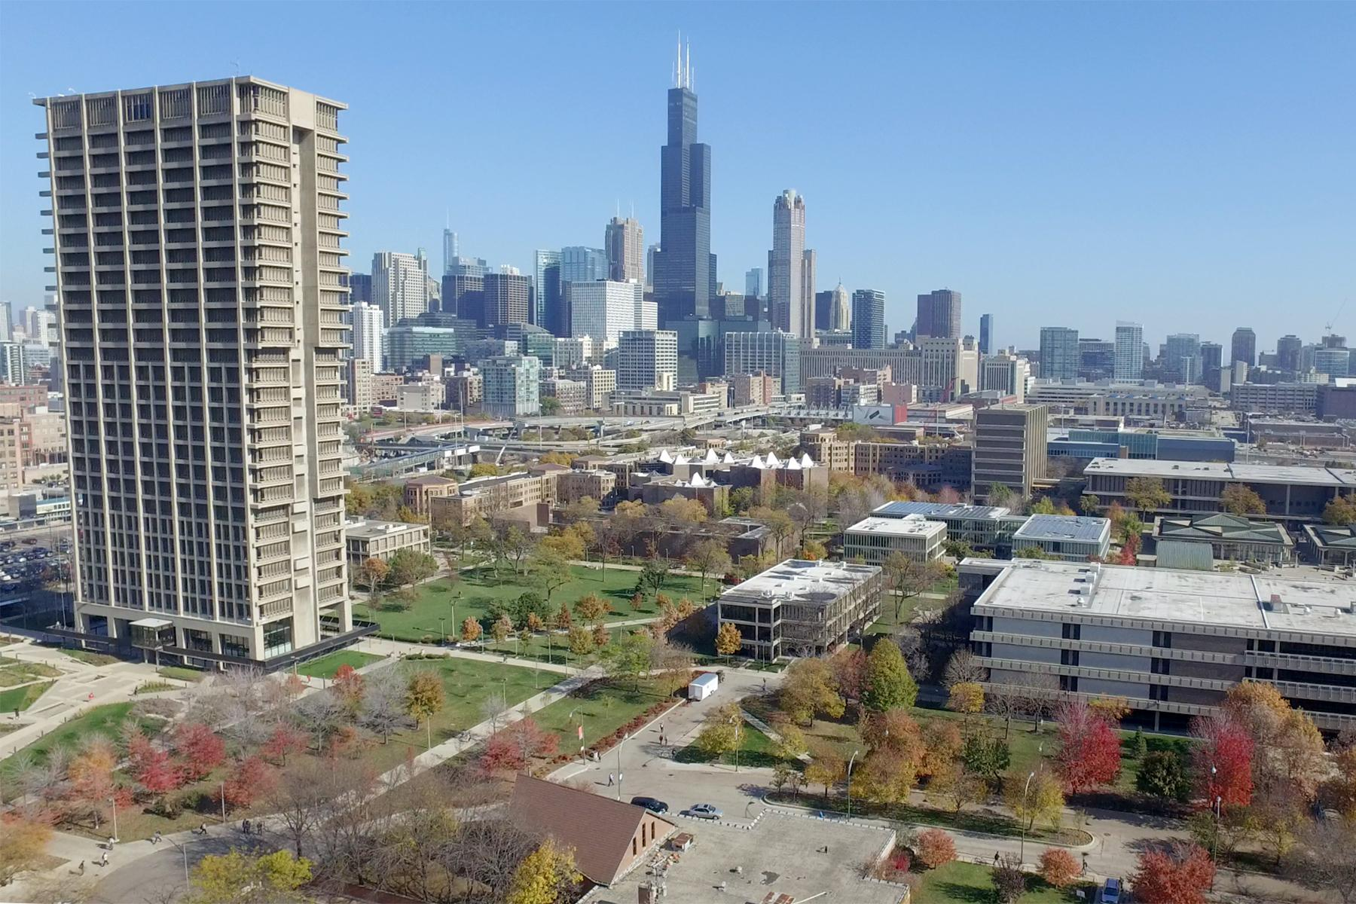
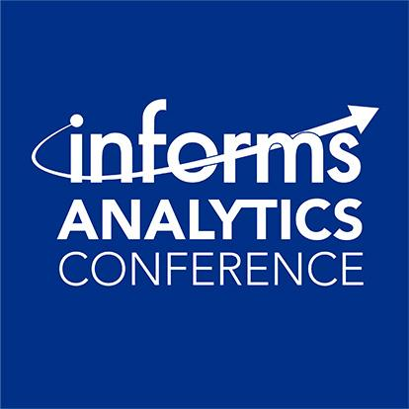



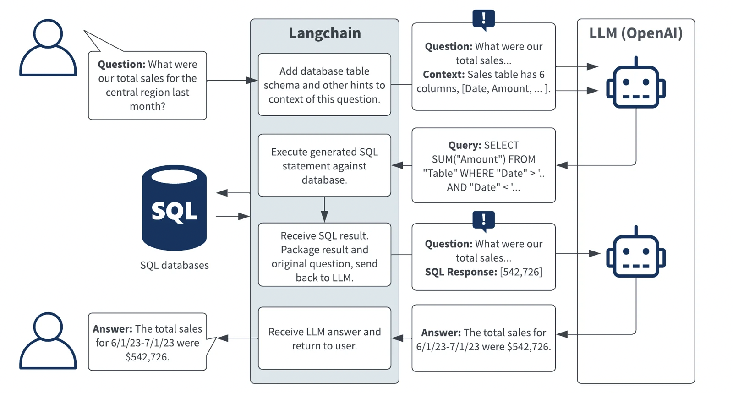
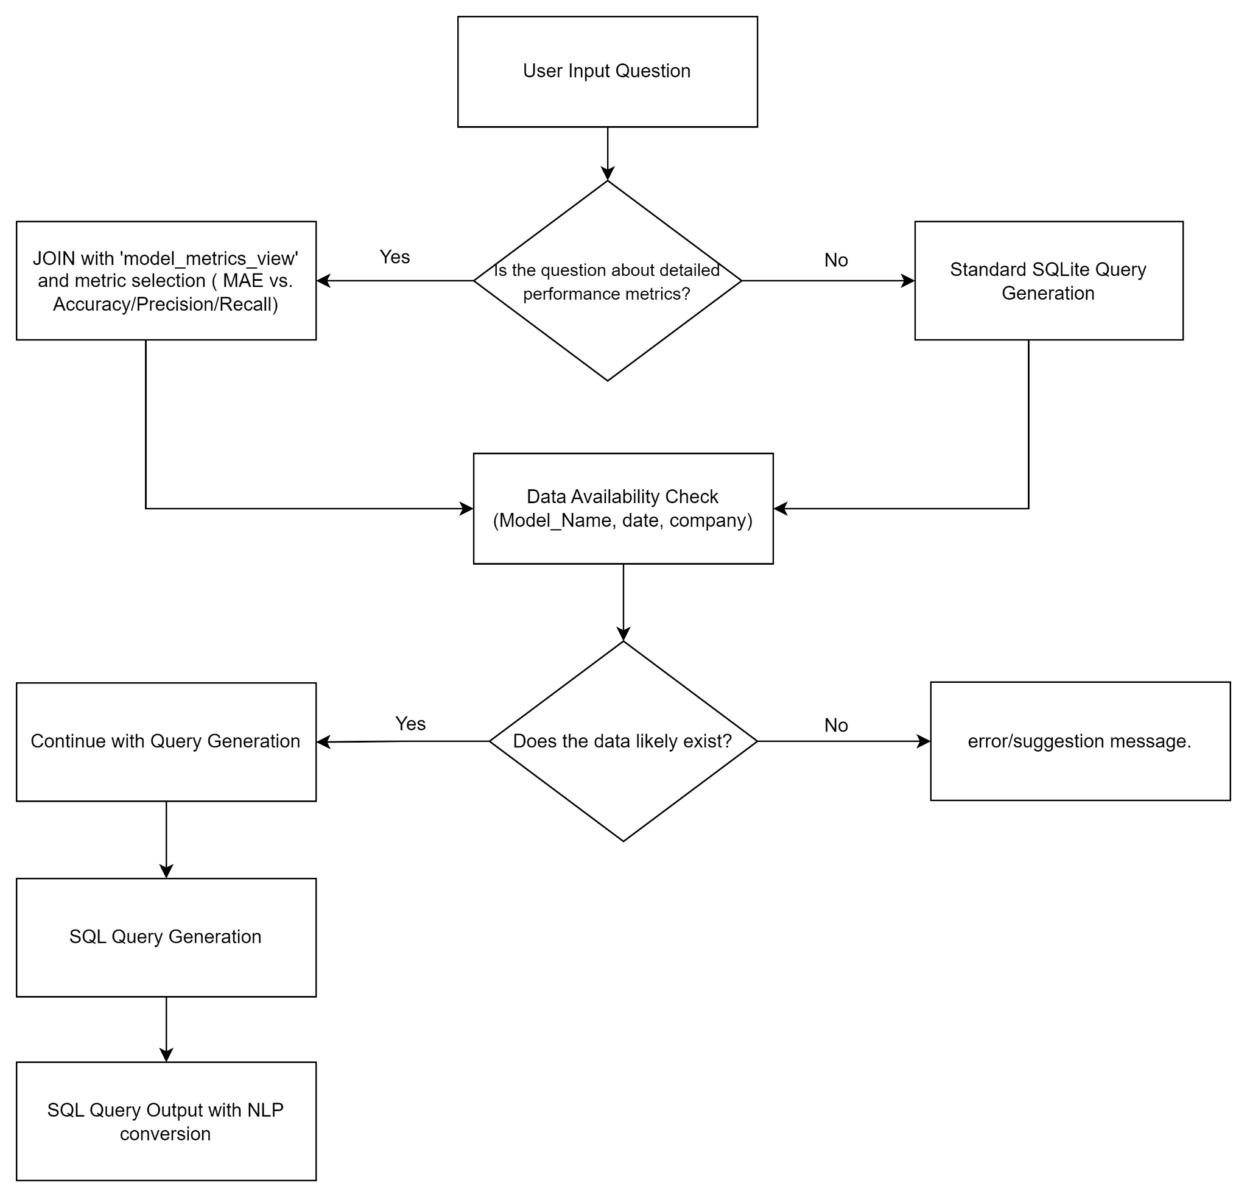
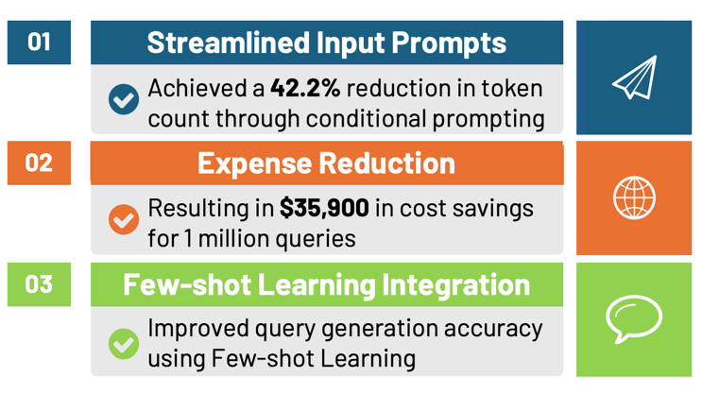



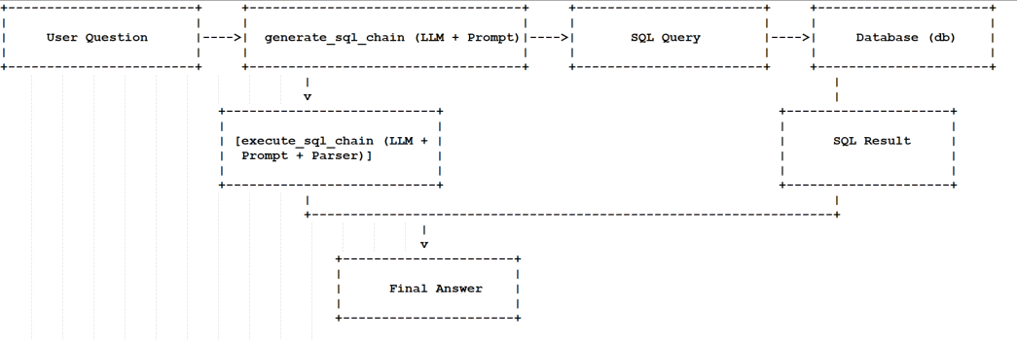
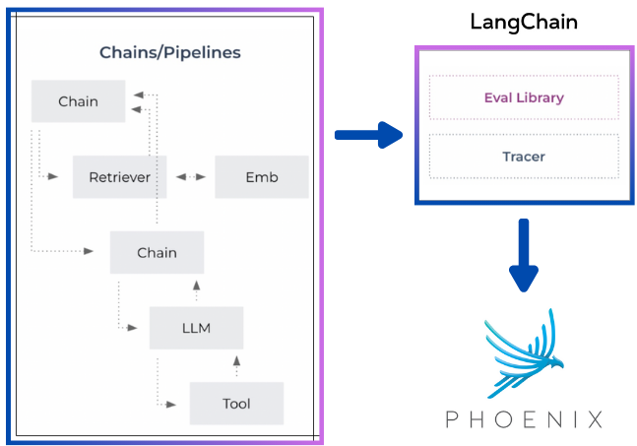

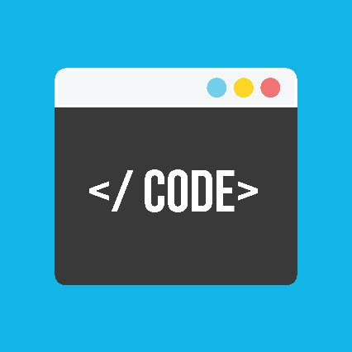
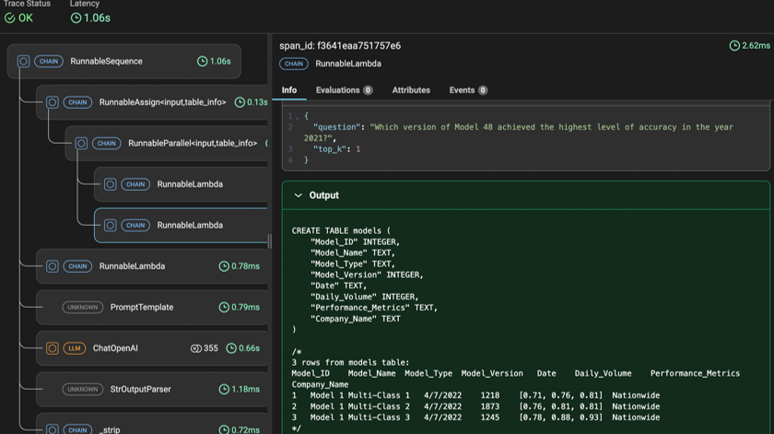
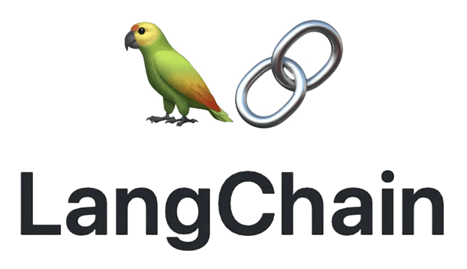
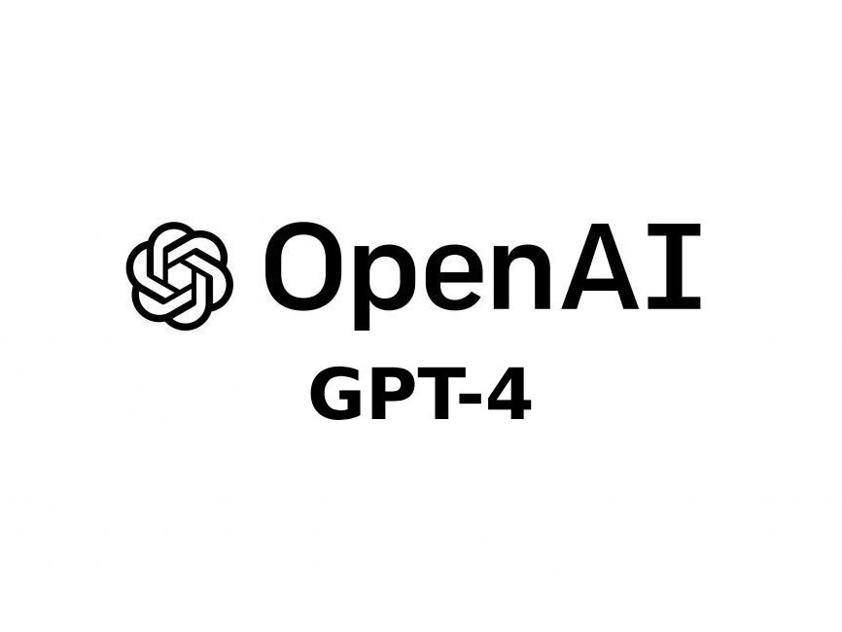

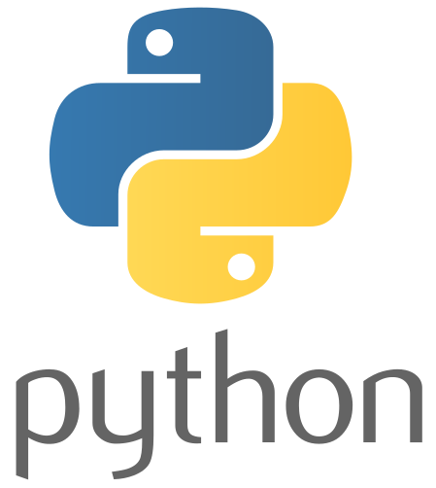
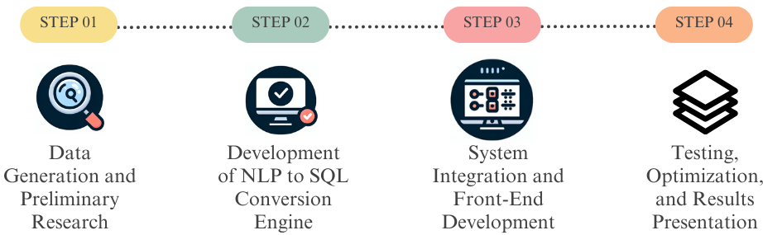

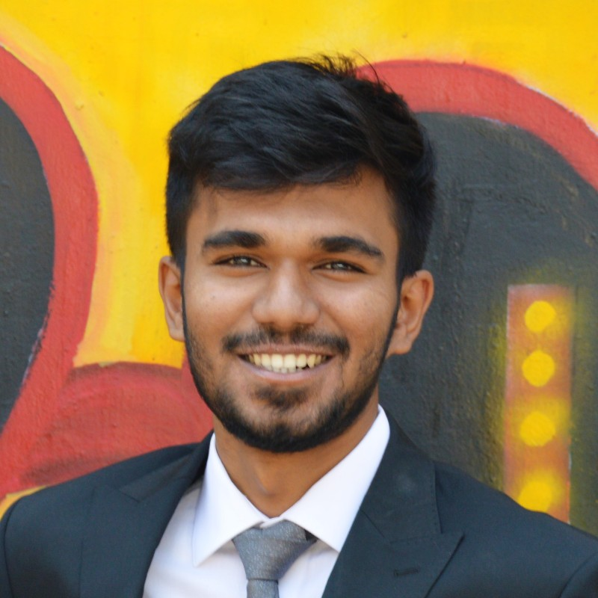


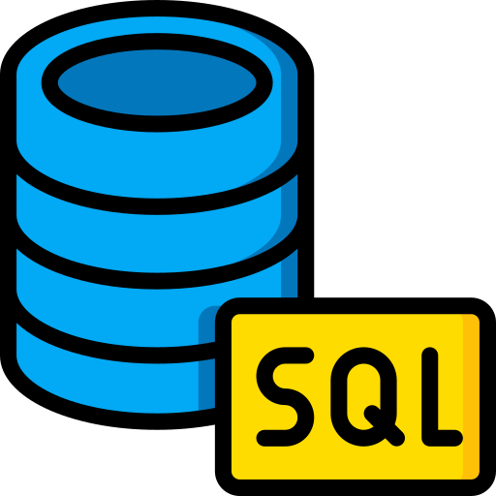
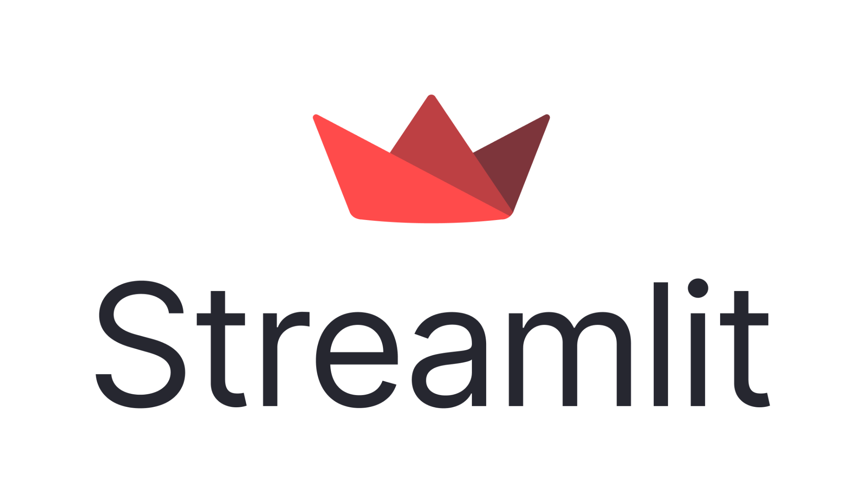

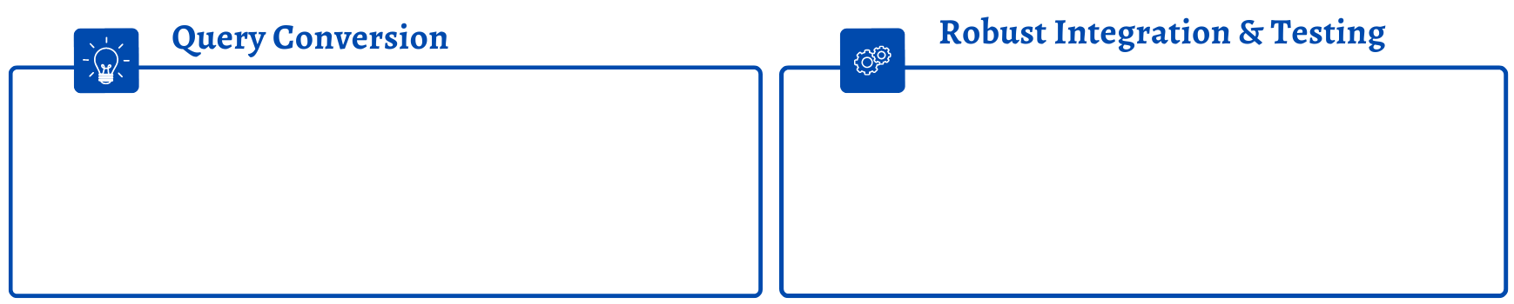

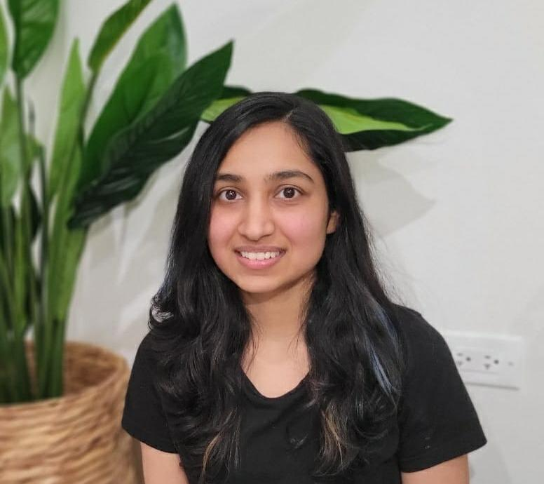
LLM-POWERED OLAP: TACKLING HIGH LEVEL BUSINESS QUESTIONS
Ainesh Panda (apanda4@uic.edu), Pragya Arora (parora27@uic.edu), Nithin Gowda (ngowda3@uic.edu), Chun Hung Lin (clin232@uic.edu), Ayushi Gaur (agaur8@uic.edu)
Faculty mentor: Prof. Fatemeh Sarayloo (fsaraylo@uic.edu)
University of Illinois at Chicago, Liautaud Graduate School of Business
Introduction
Methodology
Model Building & Results
Fine-tuning
Founded in 1980, CCC is a technology leader pioneering solutions that power insurers, automotive manufacturers, collision repairers, parts suppliers, lenders, fleet operators and more
1. Meta-Programming
for SQL Generation
2. Hallucination Mitigation
Through Data Awareness
3. Few-shot Learning
with Examples
Clientele:
300+ insurers
27000 collision repair facilities processing 16 million repairs each year
More than $1 trillion in historical claims data
The flow starts with the User asking a question, then leveraging LangChain a SQL chain is generated, which upon reaching the OpenAI framework would trigger the SQL sending the query in the database. SQL Chain is generated against the database with a parser and collectively we get both the SQL query as well as the Human form answer as a result.
We have used 4 prompts for setting up prompt engineering:
Base Prompt
Metric Prompt
Validation Prompt
Answer Prompt
Business Problem Framing
CCC wants to develop a framework to answer high-level business questions for its senior stakeholders who do not have in-depth knowledge of SQL and other technical tools.
Testing: Phoenix
Tracing is a key feature of Phoenix that allows users to track and analyze the detailed journey of every single prediction. It can help us observe the root cause of the model’s performance.
Analytical Problem Framing
Data
User Generated
15th January 2021
19th February 2024
Deployment & Lifecycle Management
Tools
Time Series Data
Deployment Server
Regression: upto 3 versions, with daily input volume, and MAE as performance metric
The Frontend was developed and customized using Streamlit libraries
Using the Streamlit server, the app was successfully deployed as a web service.
https://aioc-guardian.streamlit.app/ - App link
Consists of
50
Models
4797 rows of data
With the use of various technical tools, we can create a generative AI framework that can
Take the user input
Convert it into SQL code
Retrieve necessary data from the database
Convert it back into human language and feed it back to the user
Create a user interface
Classification: upto 3 versions, with daily input volume, and Accuracy, Precision, Recall as performance metrics
Conclusion
Acknowledgement
Ainesh Panda
Pragya Arora
Chun-Hung Lin
Developed an NLQ to SQL innovative end-to-end pipeline, reach high quality by using prompt engineering skills
Integrated NLP techniques with OLAP engines, backed by rigorous development, testing, and refinement to ensure optimal performance and UI
We wanted to thank Prof Sarayloo, and our technical supervisor Maryam Moghimi for giving us this opportunity, their guidance and support on this project
Multi-Class: upto 3 versions, with daily input volume, and Accuracy, Precision, Recall as performance metrics
Nithin Gowda
Ayushi Gaur

